Slide 1



ADAPTIVE HCI
Real-time Stabilization and 3D Reconstruction of Hand Gestures and Finger Movement Traces Using LED-Equipped Gloves Design Document
Presented by Team 5: Deniz Acikbas, Soham Naik, Zaynab Mourtada, Alan Raj

Slide 2
Project Scope & Goal
This project aims to develop a mobile app that:
Captures, stabilizes, and smooths hand gestures and finger movement traces in real-time utilizing:
LED-equipped gloves
Phone's rolling shutter camera.
Employ image processing & smoothing techniques for refining hand movements and finger traces
integrating machine learning algorithms for LED recognition and path-to-text inference
Ensure privacy by filtering irrelevant data.
Achieve 3D reconstruction of the pathway with VR viewing capabilities.
Real - Time Performance even on lower end hardware.
Smooth User Experience.
A satisfactory display of the core technologies involved in our clients research.
In this sense, our project is less user centered and more so a display of what is technically possible given pre-defined goals and constraints.

Slide 3

COMPONENTS
SOFTWARE
HARDWARE
LED Gloves (Infrared tracking)
Camera (Rolling shutter, mobile)
VR/AR Headset (for visualization)
OpenCV (for preprocessing)
YOLOv8 (for object detection)
LSTM (for inference)
TF-LITE (for mobile integration)
Unity/OpenGL (for rendering)

Slide 4
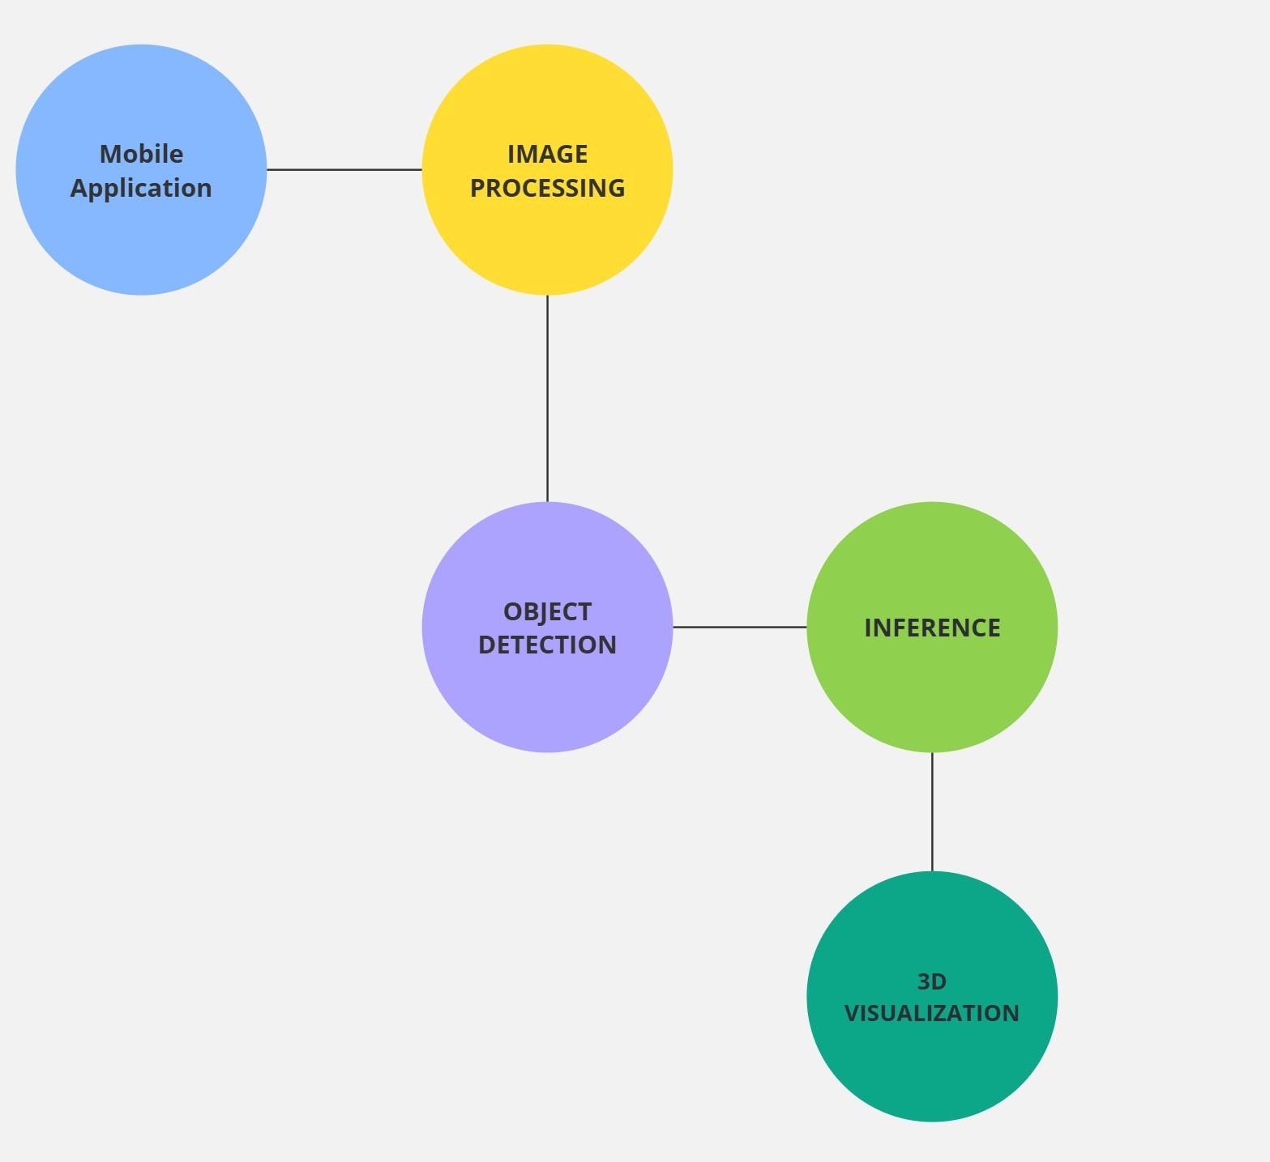
SYSTEM ARCHITECTURE
Mobile App → Captures user frames for processing.
Image Processing → Prepares frames for YOLO
Object Detection (YOLOv11N) → Identifies LED path by tracking bounding BOXES & Center of Mass
Inference (LSTM) → Converts path to text using digit/character recognition.
3D Visualization (AR) → Renders text in real-time for interaction.

Slide 5
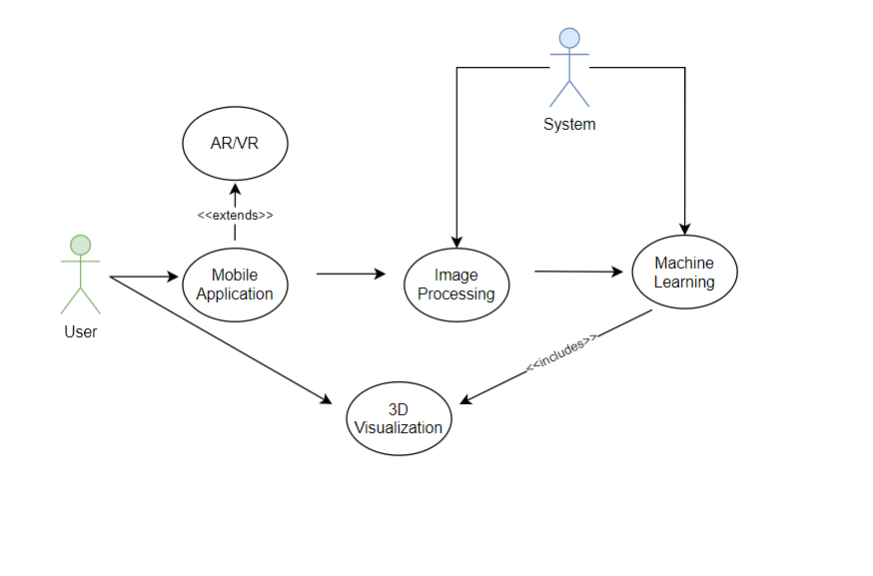
USE CASE
User interacts with Mobile App
App communicates with:
Image Processing Module → Prepares input frames for YOLO
ML Model (YOLOv8 & LSTM) → Detects hand position & predicts motion for smooth gestures
VR/AR Engine → Renders stabilized hand movements in 3D

Slide 6

SYSTEM PIPELINE
Camera Captures Raw Input
Image Processing: Greyscale, Thresholding, LetterBoxing
YOLOv8 Detects LED Position
LSTM for Inference: Converts what is written to text through digit/character recognition
3D Rendering in AR for immersive interaction

